Slide 1
DATABASES
Data storage

Slide 2
SUMMARY
Databases store data permanently (unlike RAM).
SQL databases (relational): structured tables, use SQL (e.g., PostgreSQL, MySQL).
NoSQL databases: flexible, JSON-like storage (e.g., MongoDB, Redis).
PostgreSQL: popular, free, reliable, supports many data types.
Relationships:
1:1 – One row linked to one row.
1:M – One row linked to many rows.
M:M – Many rows linked to many rows.
SQL commands: CREATE, INSERT, SELECT, UPDATE, DELETE, JOIN.

Slide 3
DATABASES
Databases allow us to store data permanently so that it can be retrieved as needed. No database. After rebooting, all data is deleted and returned to its initial state Because the data is stored in temporary memory (RAM).
There are two main types of databases: SQL databases – relational (structured) NoSQL databases are non-relational (no strict structure)
Notes:
Teacher Notes:
Contrast in‑memory storage (RAM) with persistent storage on disk.
Show a simple script or REPL session where data created in memory disappears on restart versus stored in a database.
Emphasize why applications rely on databases for durability.
Define relational (SQL) vs. non‑relational (NoSQL).
Discuss CAP theorem briefly and how it influences NoSQL design.
Use industry examples (e.g., Facebook uses MySQL; Netflix uses Cassandra/MongoDB).
Resources:
Oracle Tech Network – “What Is a Database?”
W3Schools – SQL Introduction
DigitalOcean – “SQL vs. NoSQL Databases: A Comparative Guide”
MongoDB Blog – “SQL vs NoSQL Databases”
Additional Reading:
Database System Concepts by Abraham Silberschatz, Henry F. Korth & S. Sudarshan
Seven Databases in Seven Weeks by Eric Redmond & Jim R. Wilson

Slide 4
DATABASES - SQL
SQL (Structured Query Language) is a language that allows queries over a structured database. These databases have been around for decades and are also known as relational databases. - The data is organized into tables (similar to Excel spreadsheets). - Each table contains columns that define data types. - Each row of the table is a new record. - Relationships between data allow tables to be connected. - Every blog post has a foreign key. - We can easily retrieve all posts of a particular user using SQL queries.
Notes:
Teacher Notes:
Walk through the relational model: tables, rows, columns, keys.
Live‑demo creating a simple table in PostgreSQL or SQLite CLI.
Explain primary key/foreign key relationships at a high level.
Resources:
PostgreSQL Official Docs – SQL Tutorial
W3Schools – SQL Tutorial

Slide 5
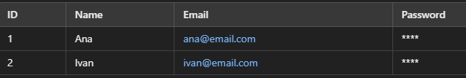
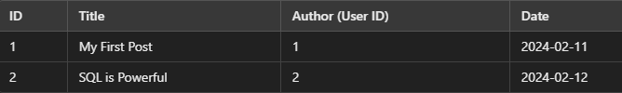
DATABASES - SQL
pgAdmin4 screenshot
- PostgreSQL (the most popular among developers!) - MySQL - SQLite - Microsoft SQL Server - Oracle Database (but costs $$$)
Notes:
Teacher Notes:
Walk through the relational model: tables, rows, columns, keys.
Live‑demo creating a simple table in PostgreSQL or SQLite CLI.
Explain primary key/foreign key relationships at a high level.

Slide 6
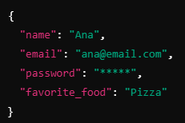
DATABASES - NOSQL
- The data is stored as JSON objects instead of tables. - There is no fixed structure, which means that we can dynamically add fields. - We can add a new field to any user without changing the entire database. - Flexibility – each user can have different attributes.
- MongoDB (the most popular NoSQL) - Redis - DynamoDB (Amazon Database)
Notes:
Teacher Notes:
Cover document, key‑value, column, and graph store distinctions.
Demo inserting a JSON document in MongoDB Compass or via mongo shell.
Discuss trade‑offs: schema flexibility versus consistency guarantees.
Resources:
MongoDB Docs – Introduction to NoSQL
Redis Docs – Getting Started

Slide 7
DATABASES – OVERVIEW
This is a controversial topic among developers. - SQL databases are structured, reliable, and efficient for large projects. - NoSQL databases are more flexible and easier for beginners, but they can cause problems with large systems. - PostgreSQL is the most popular database among professionals! ➡ MongoDB is popular among beginners, but many professional developers prefer SQL.
Why are we going to learn PostgreSQL? - Free and open-source - Fast and scalable - Reliable for large projects - Most popular among professionals
Notes:
Teacher Notes:
Show DB‑Engines ranking for SQL vs NoSQL.
Explain why PostgreSQL is widely adopted: extensibility, standards compliance, community.
Highlight open‑source advantage and ecosystem (PostGIS, JSONB).
Resources:
DB‑Engines – Ranking of Relational DBMS
PostgreSQL Official Site – About

Slide 8
DATABASES – POSGRESQL DATA TYPES
PostgreSQL offers a broader range of data types compared to standard SQL. - Textual data: VARCHAR(n) – Variable text length (maximum n characters) TEXT – Unlimited text length - Numbers: INT – Integers BIGINT – Large integers (for billions of records) DECIMAL(10,2) – Decimal numbers (e.g. prices) - Date and time: DATE – Stores only the date TIMESTAMP – Stores the date and time - Other: BOOLEAN – true/false values SERIAL – Auto-incrementing number for primary keys
Notes:
Teacher Notes:
Discuss when to choose VARCHAR(n) vs TEXT, and performance implications.
Demonstrate JSON/JSONB as an “other” type for semi‑structured data.
Show TIMESTAMP vs TIMESTAMPTZ for time‑zone handling.
Resources:
PostgreSQL Docs – Data Types
Additional Reading:
PostgreSQL: Introduction and Concepts by Bruce Momjian
SQL Performance Explained by Markus Winand

Slide 9
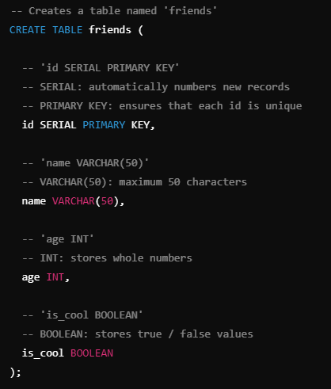
DATABASES – POSGRESQL DATA TYPES
In modern applications, TEXT is often used because there are no problems with the length limit. There is a small loss of speed, but it is more flexible for growing databases.
Notes:
Teacher Notes:
Discuss when to choose VARCHAR(n) vs TEXT, and performance implications.
Demonstrate JSON/JSONB as an “other” type for semi‑structured data.
Show TIMESTAMP vs TIMESTAMPTZ for time‑zone handling.
Resources:
PostgreSQL Docs – Data Types
Additional Reading:
PostgreSQL: Introduction and Concepts by Bruce Momjian
SQL Performance Explained by Markus Winand

Slide 10
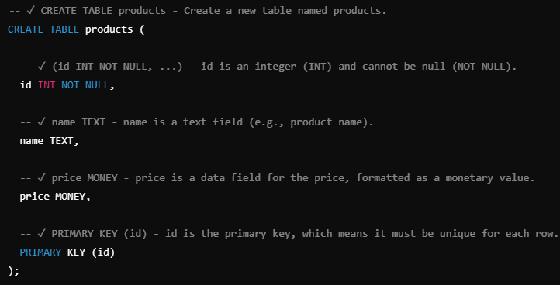
DATABASES – CREATE TABLE
SQL is a query language that we can: - Add data - Retrieve data - Update data - Clear data
Notes:
Teacher Notes:
Walk through CREATE TABLE syntax, including PRIMARY KEY and NOT NULL constraints.
Emphasize naming conventions (snake_case, singular vs plural).
Resources:
W3Schools – SQL CREATE TABLE
PostgreSQL Docs – CREATE TABLE w3schools.com/sql
sqliteonline.com

Slide 11
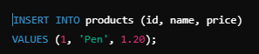

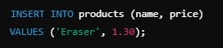
DATABASES – INSERT
- Example of adding the first product
- Adding another product (but no price)
- Example that causes the error:
Notes:
Teacher Notes:
Show INSERT INTO … VALUES (…), handling of default values, and RETURNING * in Postgres.
Demonstrate an error when inserting without a required column.
Resources:
W3Schools – SQL INSERT INTO
PostgreSQL Docs – INSERT

Slide 12



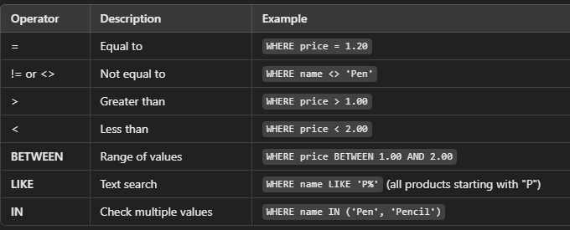
DATABASES – SELECT
- Retrieve all data - If we do not want all the columns, we can only indicate the ones that interest us - How to filter data?
Notes:
Teacher Notes:
Cover SELECT * vs. selecting specific columns and WHERE filtering.
Demonstrate simple WHERE clauses and use of comparison operators.
Resources:
W3Schools – SQL SELECT
PostgreSQL Docs – SELECT

Slide 13
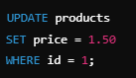
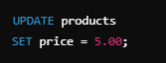
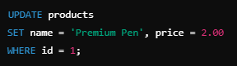
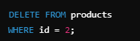


DATABASES – UPDATE & DELETE
Caution!!
- Updating data in the SQL database
- Update multiple columns at once
Caution!!
- Delete data
- How to delete ALL data but keep the table?
Notes:
Teacher Notes:
Emphasize always using a WHERE clause in UPDATE/DELETE to avoid full‑table changes.
Show how to wrap operations in transactions (BEGIN/ROLLBACK).
Demonstrate TRUNCATE to clear data but keep the schema.
Resources:
W3Schools – SQL UPDATE
W3Schools – SQL DELETE

Slide 14
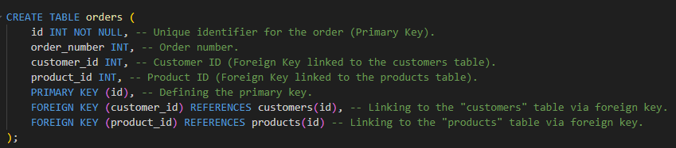
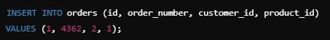
DATABASES – SQL RELATIONS & JOIN
- Primary Key (PK) – Identifies each record within the table (unique ID).
- Add your first order
Notes:
Teacher Notes:
Define Primary Key (PK) and its role in uniquely identifying rows.
Show ALTER TABLE … ADD PRIMARY KEY if needed.
Demonstrate adding a simple foreign key for an Orders table.
Resources:
W3Schools – SQL Primary Key
PostgreSQL Docs – ALTER TABLE

Slide 15
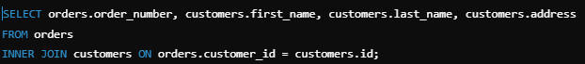
DATABASES – SQL RELATIONS & JOIN
One of the most powerful functionalities of SQL is JOIN, which allows us to join tables based on the relationships between them.
Notes:
Teacher Notes:
Use Venn diagrams to explain INNER, LEFT, RIGHT, and FULL JOIN.
Live‑demo each JOIN on a small pair of tables.
Resources:
W3Schools – SQL JOINS
PostgreSQL Docs – JOIN Queries

Slide 16
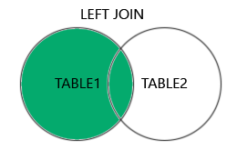
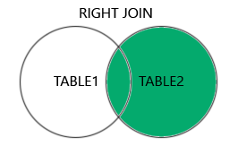
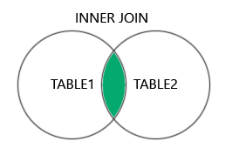
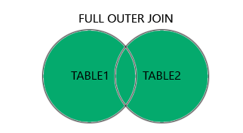
DATABASES – SQL RELATIONS & JOIN
There are different types of JOINS in SQL: - INNER JOIN – Joins only those rows that have a match in both tables. - LEFT JOIN – Includes all rows from the left table and only matching ones from the right. - RIGHT JOIN – The opposite of LEFT JOIN. - FULL JOIN – Returns all rows from both tables, regardless of match.
www.w3scholls.com
Notes:
Teacher Notes:
Use Venn diagrams to explain INNER, LEFT, RIGHT, and FULL JOIN.
Live‑demo each JOIN on a small pair of tables.
Resources:
W3Schools – SQL JOINS
PostgreSQL Docs – JOIN Queries

Slide 17
DATABASES – EXERCISE 1
Get the order number, product name, price, and stock status. Retrieve the customer's name, the product they purchased, the price, and the order number from multiple tables at the same time.
Notes:
Teacher Notes:
Provide schema for Orders, Products, Customers.
Encourage students to write a multi‑table JOIN to retrieve order number, product name, price, stock status, and customer name.
Exercise estimation time: 20 min/individual
Resources:
SQLZoo – JOIN Tutorial
CODE - https://github.com/dinoDuvnjak/CTK/blob/main/Bootcamp/DB-uvod/0.1-DB-SQL-code/sample.sql

Slide 18
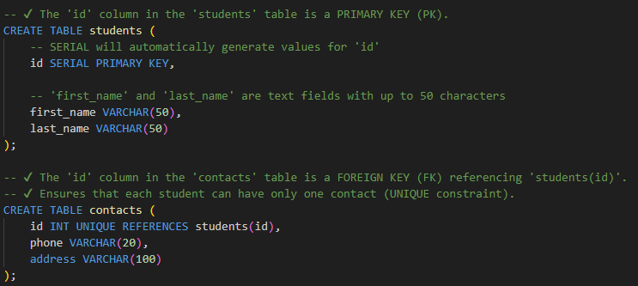
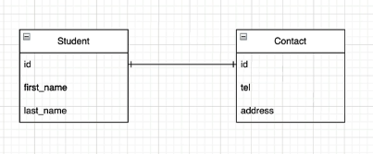
DATABASES – RELATIONAL DATABASES
Relationships allow you to connect data from multiple tables, which increases the efficiency of searching and organizing data.
This relationship means that one row in one table corresponds exactly to one row in another table. It is used to modularize the base and avoid oversized tables with too many columns.
Notes:
Teacher Notes:
Introduce Entity–Relationship (ER) modeling and normalization up to 3NF.
Show a simple ER diagram on the board.
Resources:
Lucidchart – ER Diagram Tutorial
Additional Reading:
Database Design and Relational Theory by C. J. Date

Slide 19
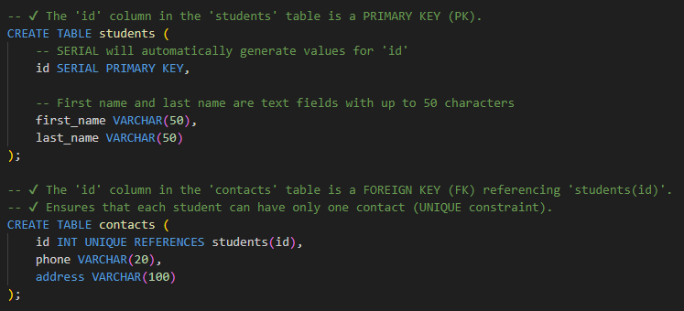
DATABASES – ONE ON ONE (1:1)
This relationship means that one row in one table corresponds exactly to one row in another table. It is used to modularize the base and avoid oversized tables with too many columns.
Notes:
Teacher Notes:
Use a User ↔ Profile example.
Demonstrate CREATE TABLE profile (user_id INT PRIMARY KEY REFERENCES users(id), …) to enforce 1 : 1.
Resources:
Tutorialspoint – One-to-One Relationship in SQL

Slide 20
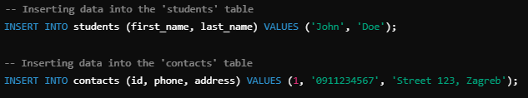
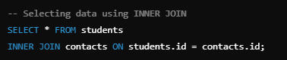
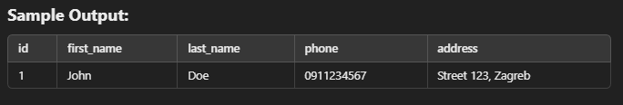
DATABASES – ONE ON ONE (1:1)
Notes:
Teacher Notes:
Use a User ↔ Profile example.
Demonstrate CREATE TABLE profile (user_id INT PRIMARY KEY REFERENCES users(id), …) to enforce 1 : 1.
Resources:
Tutorialspoint – One-to-One Relationship in SQL

Slide 21
EXERCISE
Try creating these tables in PostgreSQL on your own and testing the JOIN query! - You can add more students and their contacts. - You can experiment with adding new attributes to your tables.
Notes:
Slide 16: “DATABASES – Exercise 2”
Teacher Notes:
Assign students to create Users and Contacts tables, enforce 1 : 1 PK–FK relationship, and test a JOIN.
Exercise estimation time: 25 min/individual
Resources:
SQLBolt – Lesson: JOIN
CODE- https://github.com/dinoDuvnjak/CTK/blob/main/Bootcamp/DB-uvod/0.1-DB-SQL-code/sample.sql

Slide 22
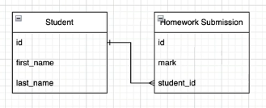
DATABASES – ONE TO MANY(1:M)
A one-to-many (1:M) relationship occurs when one record in one table can be related to multiple records in another table.
Real-life examples: - One student can submit multiple homework. - One customer can make multiple orders. - One author can write multiple books.
Notes:
Teacher Notes:
Use Customer → Orders as an example.
Explain cardinality and show diagram with crow’s foot notation.
Resources:
GeeksforGeeks – One to Many Relationship

Slide 23
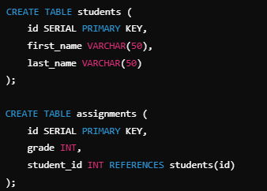
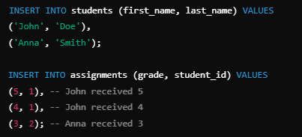
DATABASES – ONE TO MANY(1:M)
Creating Tables
Inserting data
Notes:
Teacher Notes:
Live‑demo creating tables, inserting orders, and retrieving via INNER JOIN.
Emphasize filtering specific columns.
Resources:
PostgreSQL Docs – JOIN Queries

Slide 24
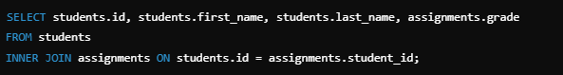
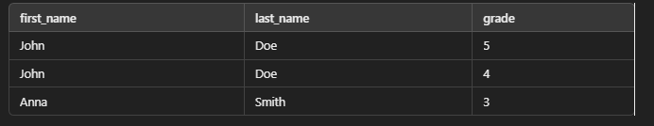
DATABASES – ONE TO MANY(1:M)
Retrieving data from INNER JOIN
Notes:
Teacher Notes:
Live‑demo creating tables, inserting orders, and retrieving via INNER JOIN.
Emphasize filtering specific columns.
Resources:
PostgreSQL Docs – JOIN Queries

Slide 25
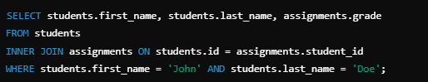
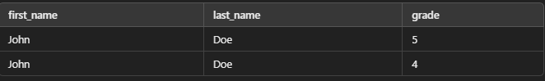
DATABASES – ONE TO MANY(1:M)
Select only specific data
Notes:
Teacher Notes:
Demonstrate SELECT u.name, o.order_date FROM users u JOIN orders o ON u.id = o.user_id.
Discuss aliasing for readability.
Resources:
W3Schools – SQL Aliases

Slide 26
EXERCISE
Try to create these tables in PostgreSQL on your own and test JOIN queries! - You can add more students and more assignments. - You can experiment with adding new attributes to tables (e.g., assignment date).
Notes:
Teacher Notes:
Ask students to model Students and Assignments in 1 : M, insert sample data, and perform JOIN queries.
Exercise estimation time: 20 min/individual
Resources:
SQLZoo – SELECT + JOIN Exercises
CODE- https://github.com/dinoDuvnjak/CTK/blob/main/Bootcamp/DB-uvod/0.1-DB-SQL-code/sample.sql

Slide 27
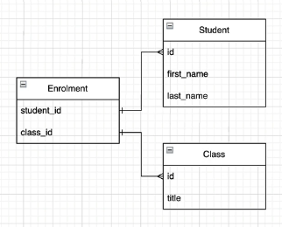
DATABASES – MANY TO MANY(M:M)
In a Many-to-Many relationship, one record in one table can be related to multiple records in another table, and vice versa.
Real-life examples: - A student can be enrolled in multiple courses, and each course has multiple students. - Customers can purchase multiple products, and each product can be purchased by multiple customers. - Authors can write multiple books, and each book can have multiple authors.
Notes:
Teacher Notes:
Explain the need for a junction table (e.g., Enrollment linking Students and Courses).
Show DDL for three tables: students, courses, enrollments.
Resources:
v

Slide 28
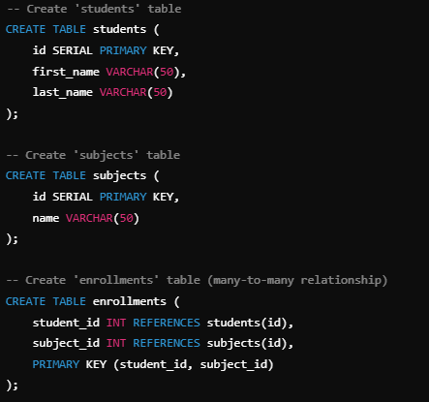
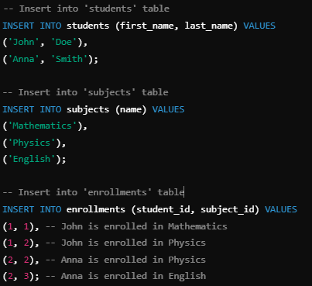
DATABASES – MANY TO MANY(M:M)
In a Many-to-Many relationship, one record in one table can be related to multiple records in another table, and vice versa.
Creating Tables
Inserting data
Notes:
Teacher Notes:
Insert sample enrollment rows and demo a JOIN across three tables.
Highlight how relational joins scale vs. nested loops in code.
Resources:
PostgreSQL Docs – Multi-table JOIN

Slide 29
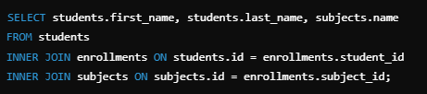
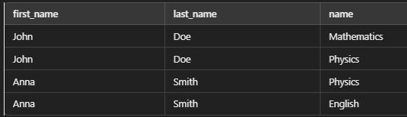
DATABASES – MANY TO MANY(M:M)
Retrieving data from JOIN
Notes:
Teacher Notes:
Insert sample enrollment rows and demo a JOIN across three tables.
Highlight how relational joins scale vs. nested loops in code.
Resources:
PostgreSQL Docs – Multi-table JOIN

Slide 30
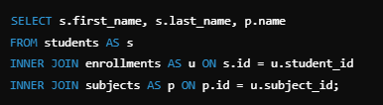
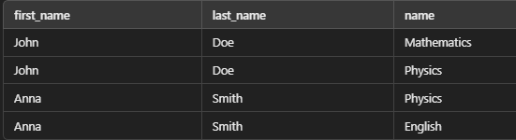
DATABASES – MANY TO MANY(M:M)
Truncate a query by using an alias (AS)
Students → S Enrollment → in Items → P
The same result, but a shorter and clearer query!
Notes:
Teacher Notes:
Show SELECT S.name, C.title FROM students AS S JOIN enrollments AS E ON S.id=E.student_id JOIN courses AS C ON E.course_id=C.id;.
Emphasize readability and maintainability.
Resources:
W3Schools – SQL Aliases

Slide 31
EXERCISE
Try to create these tables in PostgreSQL on your own and test JOIN queries! - You can add more students and subjects. - You can experiment with adding new attributes (e.g., grades in the Enrollment table).
Notes:
Teacher Notes:
Instruct students to build Students, Subjects, and Enrollment tables with extra fields (e.g., grades).
Encourage experimentation with schema evolution.
Exercise estimation time: 20 min/individual
Resources:
SQLBolt – Interactive SQL Tutorial
CODE- https://github.com/dinoDuvnjak/CTK/blob/main/Bootcamp/DB-uvod/0.1-DB-SQL-code/sample.sql

Slide 32
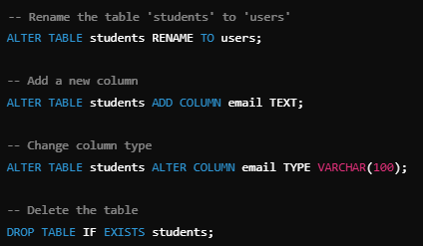
DATABASES – ALTER TABLE
Notes:
Teacher Notes:
Demonstrate ALTER TABLE users ADD COLUMN phone VARCHAR(20);
Show modifying a column type and dropping a column.
Resources:
W3Schools – SQL ALTER TABLE
PostgreSQL Docs – ALTER TABLE

Slide 33
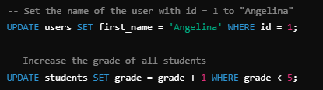
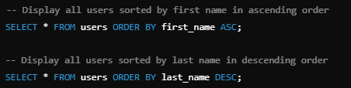
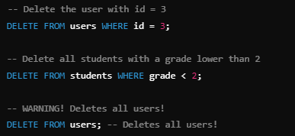
DATABASES – UPDATE,DELETE, ORDER BY
Update
Order by
Delete
Notes:
Teacher Notes:
Review UPDATE … WHERE, DELETE … WHERE, and ORDER BY column ASC|DESC.
Show a full example combining all three in a transaction.
Resources:
W3Schools – SQL ORDER BY

Slide 34
EXERCISE
Try it yourself: - Update the first_name of the user with ID 2. - Delete user with ID 5. - Sort users by last name in ascending order.
Notes:
Teacher Notes:
Task: Update first_name for user ID 2, delete user ID 5, and list all users ordered by last_name.
Encourage use of transactions (BEGIN/COMMIT).
Exercise estimation time: 30 min/individual
Resources:
SQLFiddle – Interactive SQL Playground

Slide 35
- W3Schools – SQL UPDATE
- W3Schools – SQL DELETE
- W3Schools – SQL SELECT
- PostgreSQL Docs – SELECT
- W3Schools – SQL INSERT INTO
- PostgreSQL Docs – INSERT
- W3Schools – SQL CREATE TABLE
- PostgreSQL Docs – CREATE TABLE w3schools.com/sql
- sqliteonline.com
- PostgreSQL Official Docs – SQL Tutorial
- W3Schools – SQL Tutorial
- MongoDB Docs – Introduction to NoSQL
- Redis Docs – Getting Started
- DB‑Engines – Ranking of Relational DBMS
- PostgreSQL Official Site – About

Slide 36
- W3Schools – SQL JOINS
- PostgreSQL Docs – JOIN Queries
- PostgreSQL: Introduction and Concepts by Bruce Momjian
- SQL Performance Explained by Markus Winand
- PostgreSQL Docs – Data Types
- PostgreSQL: Introduction and Concepts by Bruce Momjian
- SQL Performance Explained by Markus Winand
- Tutorialspoint – One-to-One Relationship in SQL
- Lucidchart – ER Diagram Tutorial
- Database Design and Relational Theory by C. J. Date
- W3Schools – SQL ORDER BY

Slide 37
https://www.w3schools.com/sql/sql_join.asp
https://www.oracle.com/database/what-is-database/
https://www.w3schools.com/sql/sql_intro.asp
https://www.digitalocean.com/community/tutorials/sql-vs-nosql-databases
https://www.mongodb.com/nosql-explained/nosql-vs-sql
https://www.postgresql.org/docs/current/tutorial-sql.html
https://www.postgresql.org/docs/current/tutorial-sql.html
https://www.w3schools.com/sql/
https://www.mongodb.com/nosql-explained
https://redis.io/docs/getting-started/
https://www.mongodb.com/nosql-explained
https://www.postgresql.org/docs/current/queries-table-expressions.html#QUERIES-JOIN

Slide 38
https://www.w3schools.com/sql/sql_join.asp
https://www.tutorialspoint.com/sql/sql-one-to-one-relationship.htm
https://www.geeksforgeeks.org/sql-one-to-many-relationship/
https://www.postgresql.org/docs/current/queries-table-expressions.html#QUERIES-JOIN

